Slide 1
Predicting Diabetes Risk
A Machine Learning Approach Using Health Indicators By Steven Joel Ochanda

Slide 2
Project Overview: Predicting Diabetes Risk
This presentation outlines a machine learning project aimed at developing a predictive model for diabetes risk.
My goal is to leverage readily available health indicator data to identify individuals who may be at a higher risk of diabetes.
This project demonstrates how data science and machine learning can be a powerful tool in public health initiatives and preventative medicine.

Slide 3
Business Understanding: Why Early Diabetes Prediction?
Diabetes is a chronic disease affecting millions globally, leading to serious health issues like heart disease, vision loss, and kidney disease.
Early identification of diabetes is crucial for preventative care, enabling lifestyle changes, and potentially reducing severe health complications and healthcare costs associated with the disease.
My primary audience for this project is business stakeholders in the healthcare sector, public health organizations, or insurance companies.

Slide 4
Business Understanding: Why Early Diabetes Prediction?
A reliable prediction model can help us:
Proactively Identify At-Risk Individuals: Flag individuals for early screening or targeted interventions, potentially before severe symptoms appear.
Optimize Resource Allocation: Direct healthcare resources more efficiently to those who need them most.
Inform Public Health Campaigns: Provide data-driven insights to develop more effective prevention programs.
Machine learning is ideal for this task because:
It can analyze large datasets with many variables to find complex, non-obvious patterns in health indicators that may be indicative of diabetes risk.
It allows us to build a predictive tool that can adapt and improve with more data.

Slide 5
Data Understanding
The CDC Diabetes Health Indicators Dataset
I chose this dataset because it's a comprehensive, publicly available resource from the Centers for Disease Control and Prevention (CDC).
It contains 253,680 records of healthcare statistics and lifestyle survey information from adults across the U.S..
It includes 21 features (or variables) related to general health, lifestyle, and existing conditions, which are highly relevant to diabetes risk.
The target variable, Diabetes_binary, indicates whether an individual has diabetes (1) or not (0)."

Slide 6
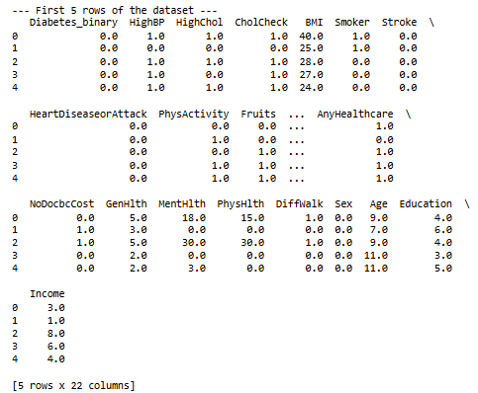
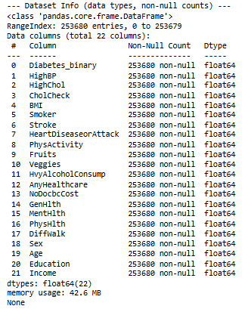
Initial Data Snapshot

Slide 7
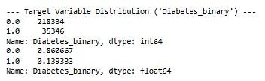
A Critical Challenge: Class Imbalance
A significant challenge we immediately identified was the severe imbalance in our target variable:
Approximately 84% of individuals do NOT have diabetes (Class 0).
Approximately 15% of individuals DO have diabetes (Class 1).
If a model simply predicts 'No Diabetes' for everyone, it will achieve 84% accuracy. However, it would completely miss identifying actual diabetes cases, which is unacceptable for our goal of early risk identification.

Slide 8
Data Preparation & Preprocessing
Step 1: Handling Duplicate Records
Upon initial inspection, i identified 24,206 duplicate rows within the dataset. I removed them, leaving me with 229,474 unique records for my analysis.
Step 2: Separating Features and Target Variable
My independent variables (features, denoted as 'X') – which are the 21 health and lifestyle indicators – and my dependent variable (target, denoted as 'y') – Diabetes_binary."

Slide 9
Data Preparation & Preprocessing
Step 3: Splitting Data into Training and Testing Sets
I divided my dataset into two parts:
Training Set (80%): Used to teach the model patterns in the data."
Testing Set (20%): Used to evaluate how well our trained model performs on data it has never seen before, simulating real-world application.
Preventing Data Leakage: I used a technique called stratified sampling (stratify=y) during the split. This ensures that the proportion of 'Diabetes' (Class 1) and 'No Diabetes' (Class 0) cases is maintained equally in both the training and testing sets.

Slide 10
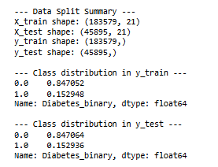
Data Split Summary

Slide 11
Data Preparation & Preprocessing
Step 4: Feature Scaling
I applied StandardScaler to transform our features. This scales the data so that it has a mean of 0 and a standard deviation of 1, effectively standardizing the range of all features.
Preventing Data Leakage :
Fitting the StandardScaler ONLY on the training data (X_train). This means the scaler learns the mean and standard deviation exclusively from the training set.
Transforming BOTH the training data (X_train) and the testing data (X_test) using the scaler fitted on the training data.

Slide 12
Addressing Class Imbalance: Ensuring Fair Prediction
As highlighted earlier, our dataset is severely imbalanced, with roughly 84% 'No Diabetes' cases and only 15% 'Diabetes' cases.
Strategy 1: Model-Level Adjustment (class_weight='balanced’)
This parameter automatically adjusts the weights of the classes during training.
Strategy 2: Data Resampling with SMOTE (Synthetic Minority Over-sampling Technique)
SMOTE generates new, synthetic data points that are similar to existing minority class samples but are not exact copies.
By creating a more balanced training environment, SMOTE enables my models to learn robust patterns for both classes, significantly improving their ability to detect diabetes cases.

Slide 13
Model Selection & Iterative Evaluation (Results)
Key Performance Metrics Explained
Accuracy: The overall proportion of correct predictions.
Confusion Matrix: A table that shows where our model made correct and incorrect predictions.
True Negative (TN): Correctly predicted No Diabetes.
False Positive (FP): Incorrectly predicted Diabetes (false alarm).
False Negative (FN): Incorrectly predicted No Diabetes (missed diagnosis).
True Positive (TP): Correctly predicted Diabetes.
Precision (for Diabetes): Out of all cases predicted as Diabetes, how many were actually Diabetes. High precision reduces false alarms.
Recall (for Diabetes - Critical for our goal): Out of all actual Diabetes cases, how many did our model correctly identify. High recall minimizes missed diagnoses.
F1-Score (for Diabetes): A balance between Precision and Recall.
AUC (Area Under the ROC Curve): Measures the model's ability to distinguish between classes. A higher AUC (closer to 1) indicates better discrimination.

Slide 14
Model 1: Logistic Regression
Results on Test Set: Overall Accuracy: 71.42%
Confusion Matrix:
True Negatives (No Diabetes identified correctly): 27,445
False Positives (No Diabetes incorrectly identified as Diabetes): 11,431
False Negatives (Actual Diabetes missed): 1,686
True Positives (Actual Diabetes identified correctly): 5,333
Key Metrics for Diabetes (Class 1):
Precision: 0.32
Recall: 0.76
F1-Score: 0.45
AUC Score: 0.81

Slide 15
Model 2: Logistic Regression with SMOTE
Results on Test Set: Overall Accuracy: 71.96%
Confusion Matrix:
True Negatives: 27,520
False Positives: 11,356
False Negatives: 1,707
True Positives: 5,312
Key Metrics for Diabetes (Class 1):
Precision: 0.32
Recall: 0.71
F1-Score: 0.49
AUC Score: 0.81

Slide 16
Model 3: Decision Tree Classifier with SMOTE
Results on Test Set: Overall Accuracy: 78.87%
Confusion Matrix:
True Negatives: 31,771
False Positives: 7,105
False Negatives: 3,052
True Positives: 3,967
Key Metrics for Diabetes (Class 1):
Precision: 0.36
Recall: 0.57
F1-Score: 0.44
AUC Score: 0.79

Slide 17
Model 4: Random Forest Classifier
Results (without SMOTE): Overall Accuracy: 98.88%
Confusion Matrix:
True Negatives: 37,669
False Positives: 1,207
False Negatives: 5,977
True Positives: 1,042
Key Metrics for Diabetes (Class 1):
Precision: 0.46
Recall: 0.15
F1-Score: 0.26
AUC Score: 0.78

Slide 18
Model 5: Random Forest Classifier with SMOTE
Results on Test Set: Overall Accuracy: 83.50%
Confusion Matrix:
True Negatives: 36,398
False Positives: 2,478
False Negatives: 5,094
True Positives: 1,925
Key Metrics for Diabetes (Class 1):
Precision: 0.44
Recall: 0.27
F1-Score: 0.34
AUC Score: 0.78

Slide 19
Best Model Analysis, Limitations, & Recommendations
The Decision Tree Classifier trained with SMOTE-resampled data stands out as our best performing model for this project, particularly when considering the crucial goal of identifying actual diabetes cases.
While its overall accuracy of 78.87% is slightly lower than the Random Forest's (without SMOTE), its performance on the minority 'Diabetes' class is significantly better and more balanced.

Slide 20
Limitations of my Model and Approach
False Negatives Exist: Despite my efforts, the model still generates 3,052 False Negatives.
False Positives Impact: The 7,105 False Positives could lead to unnecessary follow-up tests, anxiety, and healthcare costs for individuals who are not diabetic.
Stakeholders need to consider the cost-benefit of these 'false alarms' versus the benefit of identifying more true cases."

Slide 21
Recommendations
For Stakeholders:
This model should be deployed as an initial screening tool. It can identify individuals who exhibit a higher risk profile for diabetes based on their health indicators. These flagged individuals can then be prioritized for further, more definitive medical testing and consultation, optimizing healthcare resource allocation.

